Slide 1
Measuring and Tracking HSTP-II TB case detection rate for all forms of TB
Ethiopian Public Health Institute
National Data Management Center for Health
Mandefro L. Kejela
Zenabu Reda
Asrat Arja

Slide 2
Background
Tuberculosis (TB)
is a communicable disease that is a major cause of ill health and one of the leading causes of death worldwide.
Until the coronavirus (COVID-19) pandemic,
TB was the leading cause of death from a single infectious agent, ranking above HIV/AIDS [1].
The rate of TB case detection is one of the metrics used to evaluate the disease.
According to WHO [1]
TB case detection rate for all forms of TB refers to the proportion of estimated new and relapse tuberculosis (TB) cases detected in a given year under the internationally recommended tuberculosis control strategy.

Slide 3
Background…
Ethiopia has prepared the HSTP-II, an ambitious but achievable transformation plan
The period of 2021/22 – 2024/25 (2013 – 2017 EFY) [2]
Under the Disease Prevention and Control thematic area is found TB case detection rate for all forms of TB
Tuberculosis case detection rate (%, all forms) in Ethiopia was reported at 73% in 2021

Slide 4
Background…
The HSTP-II plan document estimates
the TB case detection rate (all forms) to reach 76% and 81% in the midterm 2022 and 2024/25 respectively from the baseline of 71%.
This work is aimed at tracking and measuring TB case detection rate for all forms of TB from the among HSTP-II indicators

Slide 5
Statement of the Problem
Monitoring the indicators' performance aids in performance evaluation and, consequently, self-checking.
TB receives high priority, and the ongoing evaluation of its detection rate supports the eradication effort.
Numerous reliable sources [1], [5], Ethiopia's nationwide rate of TB case detection (of all kinds) is 73% for the year 2022.
All of the reports, only cover the national TB detection rate
The ministry and other stakeholders can better grasp the disease's detection rate
regional and zonal levels of granularity

Slide 6
Review of Literatures
Martien W. Borgdorff, “New Measurable Indicator for Tuberculosis Case Detection,”
TB incidence rate utilized to compute the detection rate is uncertain and is estimated rather than measured.
This leads to an uncertain detection rate.
It proposed a new indicator: Patient Diagnostic Rate.
Suggests it has a more predictable outcome than detection rate
Needs TB Prevalence Survey
Ethiopia has not undertaken TB Prevalence Survey in 2011.

Slide 7
Review of Literatures…
In the 2022 annual TB Report
Widely used as a reference in many circumstances
Three sub-Saharan high TB burden countries have reached or passed the first milestone
Kenya (2018), Tanzania (2019) and Zambia (2021)
Ethiopia didn’t reach but very close
Global TB report

Slide 8
Objectives
Major Objectives:
To measure and track the TB case detection rate for all forms of TB.
Specific Objectives:
Perform data gap/discrepancy analysis among TB case detection data sources
Analyze historical trends and project the TB detection rate of all forms for HSTP-II and End TB Target
Provide geospatial based TB detection rate of all forms at the zonal level
Investigate determinant factors that can be used for TB case detection rate of all forms, TB treatment success rate and Number of DR TB Cases Detected
Perform catastrophic health expenditure associated with TB disease

Slide 9
Methodology
Methodologies being employed:
Desk Review: related works from WHO, GBD, MoH, and EPHI has been reviewed.
Data Source: DHIS-2 was used.
NTB-SQA, HDV, HPD, HFD, WHO and GBD estimate,
Data Extraction and Mapping: Necessary features were extracted
Data Analysis: The data was examined.
Data Modeling: a machine learning algorithm developed to measure and track indicators related to TB.
The results will then be evaluated against the targets set on the HSTP-II.
Data Visualization: Data visualization dashboard was developed

Slide 10
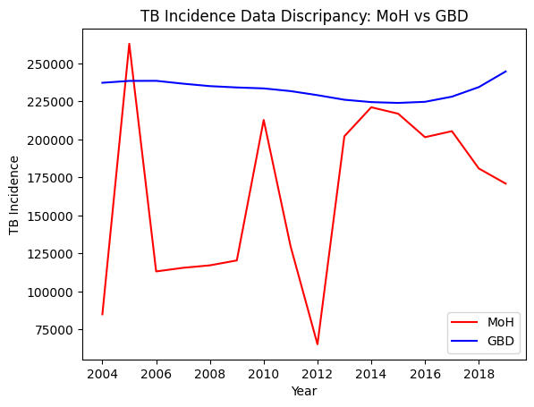
Data-Decrepancy

Slide 11
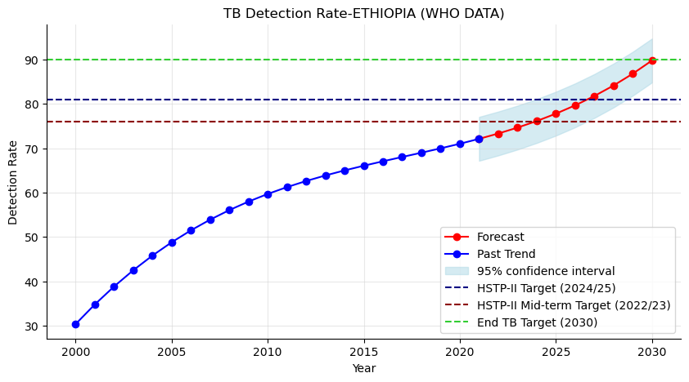
Preliminary Result

Slide 12
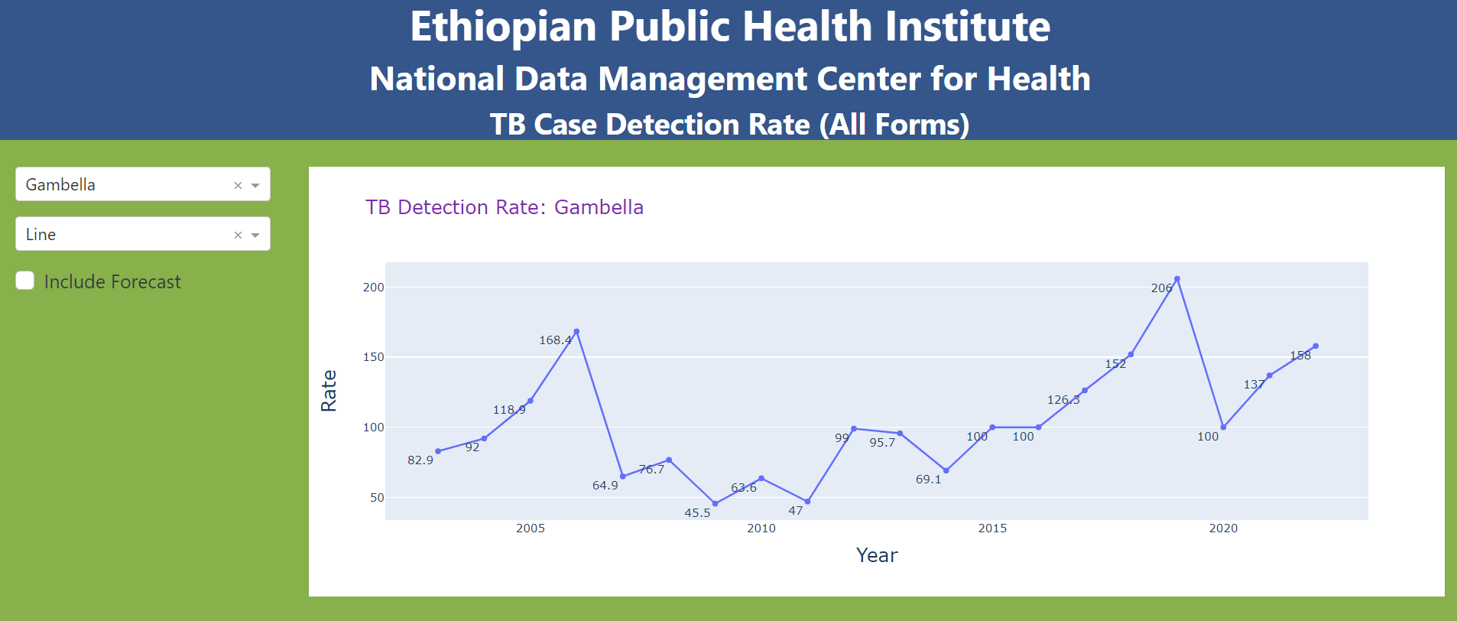
The Dashboard

Slide 13
Ongoing Activities
Identifying source of data discrepancy
Forecast detection rate at the sub-national level
Regional, Zonal with Geo-Spatial Information
Maturing the Dashboard
Investigation of the determinant factors that can be used for TB case detection rate of all forms, TB treatment success rate and Number of DR TB Cases Detected
Performing catastrophic health expenditure associated with TB disease

Slide 14
Feedback, Q & A

Slide 15
Thank You!!!

